Slide 1
NE 763: Advanced Reactor Materials
Fall 2026
Dr. Benjamin Beeler

Slide 2
Exam 3 Grades
Avg: 86.7
Stdev: 5.8
Curve: 5 points
Solutions on moodle
Come talk to me about any questions or concerns
Only Exam 4 is left
Planned for last day of classes: Dec. 2
if this doesn’t work or conflicts with other class schedules, let me know

Slide 3
Last Time
Why do we need advanced materials for cladding?
Austenitic steels undergo excessive void swelling in fast reactor conditions
Why F/M steels?
have good mechanical properties, are cheap, and their microstructure can be tailored through composition and fabrication
Microstructure of F/M steels?
ferrite grains with martensite laths; M23C6 and monocarbide precipitates are prevalent both along grain boundaries and within the grains; M2X metallic precipitates form and can be converted to Laves phases
Tailoring of alloying elements has allowed for improved creep strength
impacts precipitation and solid solution strengthening

Slide 4
Void Swelling
Void swelling depends crucially on the structure of the matrix lattice, in which irradiation produces the excess defects
There are several reasons why the swelling resistance in ferritic steels is better than austenitic steels
First, the relaxation volume for interstitials is large in ferrite than in austenite
Thus, for a given interstitial, the strain field is larger in ferrite, which has the impact of more strongly repelling other interstitials, and more strongly attracting vacancies
Second, the migration barrier of vacancies in ferrite is much lower than in austenite (0.55 eV to 1.4 eV)
Since vacancies are more mobile in ferrite, recombination is more likely with the dispersed isolated interstitials
Third, excess vacancies can be trapped at carbide particles, of which there is a high number density, as the C-vacancy binding energy in ferrite is twice that in austenite

Slide 5
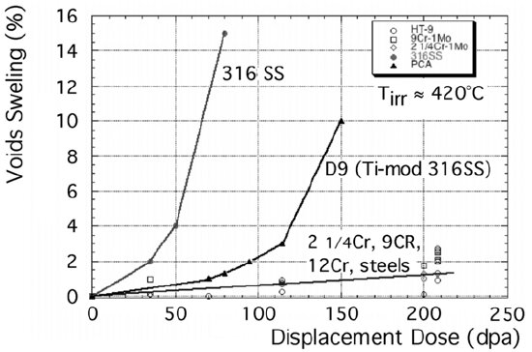
Void Swelling
Fourth, the way dislocations and solutes interact in ferrite makes them strong sinks, generating strain fields that attract vacancies and provide a high sink density
Finally, the complex microstructure of martensite laths and a ferrite matrix inherently produces a very high density of sinks, with some arguing the fundamental microstructure of F-M steels governs the improved swelling behavior
Some combination of all of these factors likely contribute

Slide 6
Ferritic/Martensitic Steels Summary
Austenitic steels undergo excessive void swelling in fast reactor conditions
F/M steels have good mechanical properties, are cheap, and their microstructure can be tailored through composition and fabrication
M23C6 and monocarbide precipitate are prevalent both along grain boundaries and within the grains
Tailoring of alloying elements has allowed for improved creep strength
Embrittlement is caused by segregation of elements to lath boundaries and evolution of precipitates
DBTT shift is minimized for 9Cr steels
F/M steels swell very little, one of the key features making them suitable for application

Slide 7
Fe-Cr-al steels

Slide 8
FeCrAl
FeCrAl alloys are expected to have excellent high temperature corrosion behavior and very low void swelling, making them viable candidates for both LWR and advanced reactors
Strong push over the last 10 years to develop FeCrAl after Fukushima, including it as an accident tolerant fuel concept
Alloying additions are weighed to target properties and microstructure
Al allows for formation of Al2O3, limiting high T steam corrosion
Too much Cr leads to sigma phase and alpha’ which cause embrittlement, while too much Al leads to the formation of Al intermetallics
Cr and Al act as bcc stabilizers such that FeCrAl is fully ferritic
Other alloying species are added to increase strength, modify precipitation, etc.

Slide 9
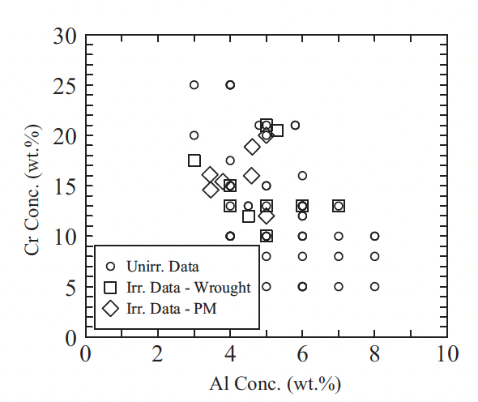
Compositional Limits
A range of alloys have been studied for radiation tolerance utilizing different fabrication techniques
Typically operate from 5-25 wt.%Cr and 2-8wt%Al
If too little Cr/Al is present, get poor high temperature corrosion resistance
To much Cr/Al, embrittlement and fabrication issues
To much of either Cr or Al, unfavorable precipitation behavior
Unirradiated and irradiated compositions studied for FeCrAl alloys for both ingot metallurgy derived and powder metallurgy samples

Slide 10
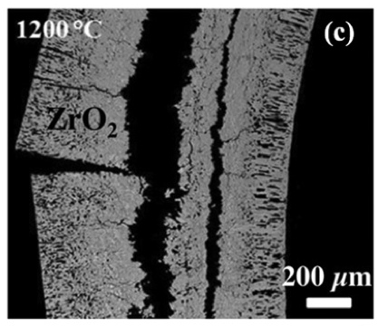
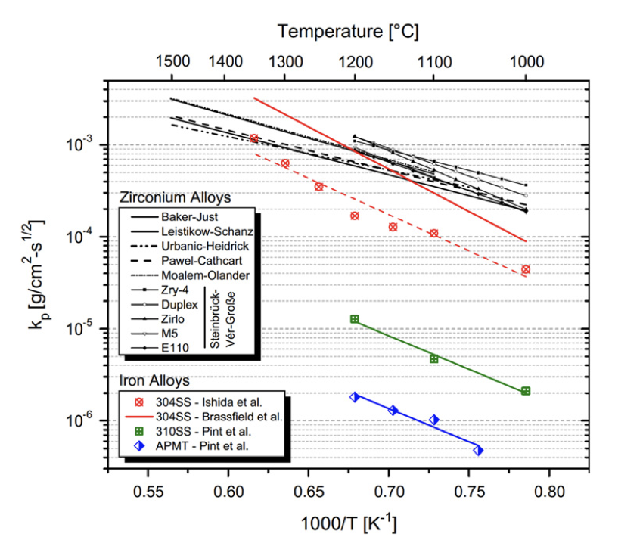
Oxidation Resistance
For applications in LWRs or other water-cooled systems, current cladding (zircaloy) exhibits excessive oxidation at T > 1200 C
FeCrAl can form a stable Al2O3 layer on the surface that is relatively resistant to high temperature steam corrosion
Comparing rate constants of zircaloy, SS, and FeCrAl (APMT), significant oxidation resistance is gained for FeCrAl
Al2O3 is significantly more stable at very high T than either Cr2O3 or ZrO2

Slide 11
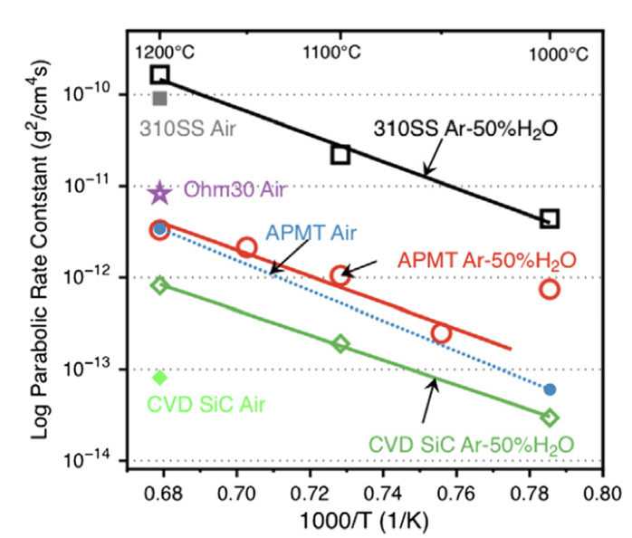
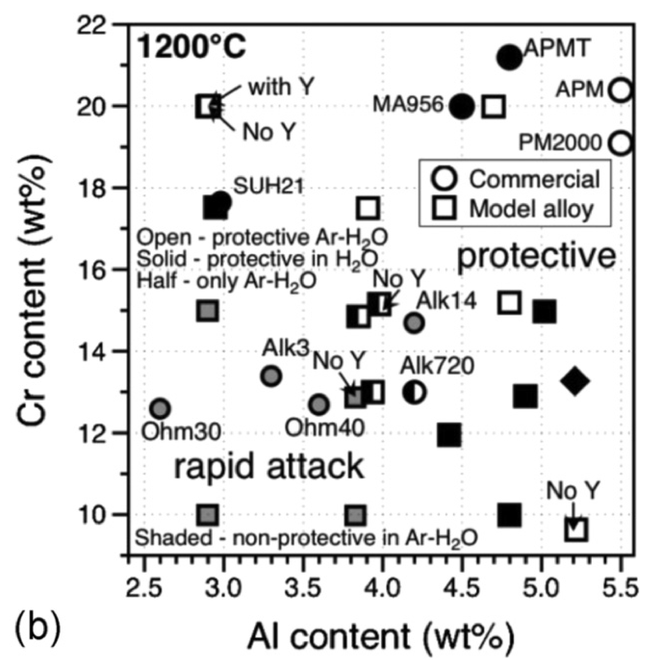
Oxidation Resistance
The composition of the FeCrAl alloy determines its ability to form passivating layers at high T
At a chromium content of 10 wt%, alloys investigated with Al content < 4.5 wt% did not form protective oxide scales
With increasing Cr and Al content, e.g., 12wt% Cr and 4.5 wt% Al, protective scales formed
At ~18 wt% Cr and as low as 3 wt% Al content, a protective oxide can still be formed
This oxidation behavior, in conjunction with irradiation behavior (coming next), determines viable composition ranges of FeCrAl

Slide 12
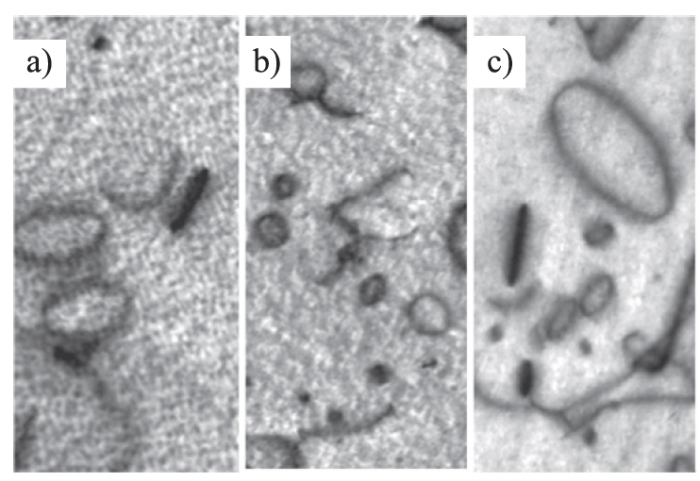
Irradiation Behavior
Effectively no void swelling has been observed up to 23 dpa and 600C
These alloys are expected to display excellent void swelling resistance characteristic of ferritic alloys
Both vacancy and interstitial loops of specific orientations are known to form, regardless of minor compositional variances
Loop size and density are impacted by composition and as-fabricated microstructure

Slide 13
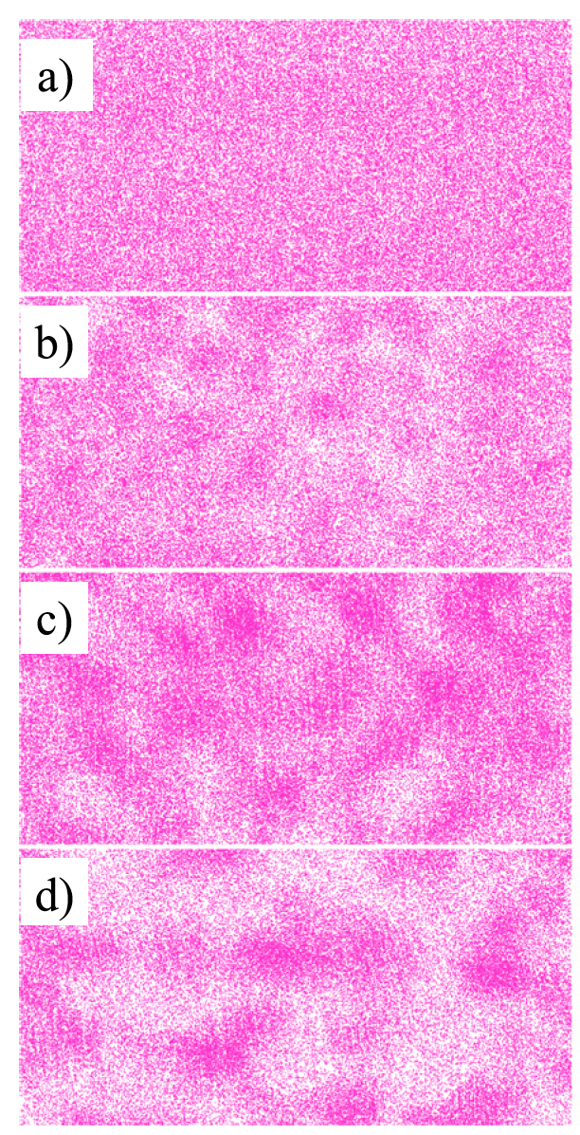
alpha’ Precipitation
Like other high-Cr ferritic alloys, FeCrAl alloys have been shown to be susceptible to irradiation-enhanced precipitation of the Cr-rich alpha’ phase
Embrittlement due to alpha’ formation has a high likelihood of being the primary factor dictating the useful lifetime of FeCrAl components
Aluminum is believed to inhibit, but not prevent, alpha’ precipitation
Irradiation enhanced diffusion accelerates the Cr precipitation, reducing the temperature and Cr-content at which alpha’ is expected to form
Atom probe tomography Cr atom maps during neutron irradiation

Slide 14
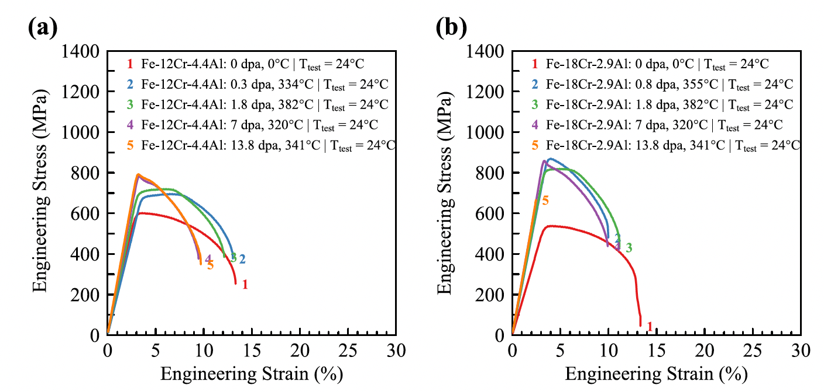
Irradiation Hardening
FeCrAl shows pronounced increases in yield strength and corresponding decreases in total elongation due to dislocations and alpha’ precipitates
The general trend is an initial regime where the yield strength steeply increases with increasing dose and then reaches a saturation
Saturation is typically around 10% elongation
Some high-Cr alloys have shown a third stage of complete embrittlement

Slide 15
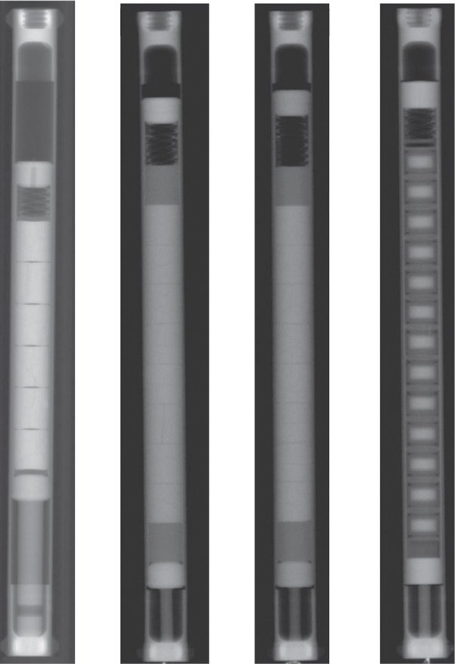
Integral Experiments
FeCrAl is still relatively poorly explored in integral expts
Only a handful of irradiation+corrosion tests; only a handful of fueled cladding tube tests
No major issues identified, but nothing extended to high burnup or transients
So, it is a promising material, but still a long way to go to verify its suitability

Slide 16
ODS Steels

Slide 17
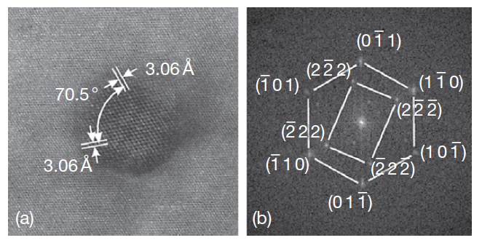
Oxide Dispersion Strengthened Steels
Thermally stable oxide particles dispersed in the ferritic matrix improve the radiation resistance and creep resistance at high temperature
ODS steels have a strong potential for high burnup and high temperature applications typical for SFR fuels
Allow the system to retain essentially a fixed microstructure with irradiation
Typically, Y2O3 particles or Y2Ti2O7 particles
HRTEM of Y2O3 particle with surrounding matrix

Slide 18
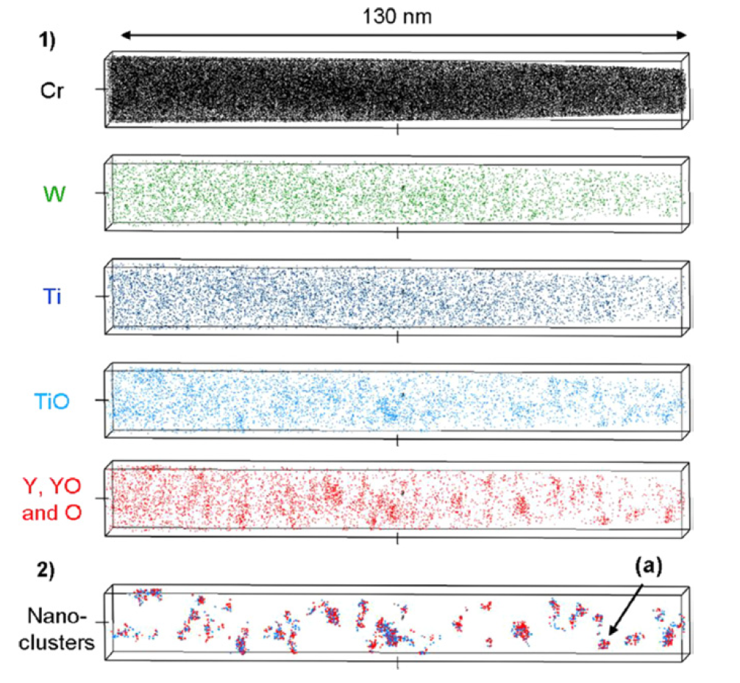
Y2O3 Decomposition
The fine distribution of Y2O3 particles is attained by the dissociation of stable Y2O3 particles which are forced to decompose into the ferritic steel matrix during the mechanical alloying (MA) process
The lattice structure change of Y2O3 in the ODS steel during MA consists of three stages: (1) destruction of the lattice structure, (2) formation of a blurry lattice structure, (3) appearance of amorphous areas
Particles precipitate under heat treatment

Slide 19
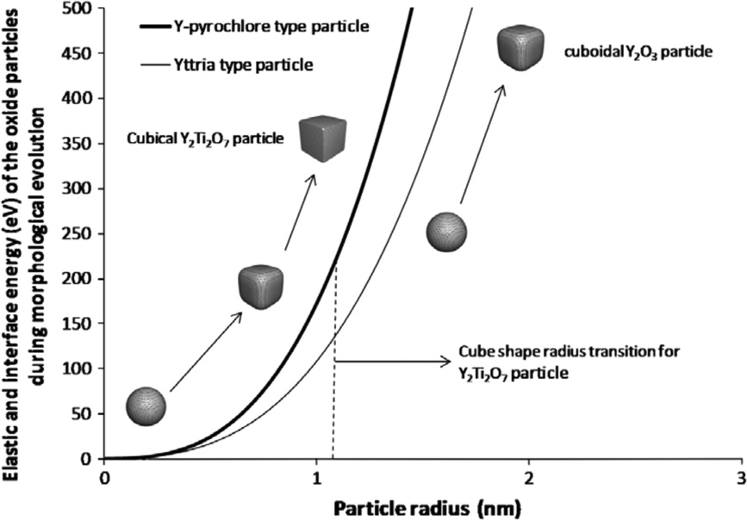
Oxide Particle Structure
The structure of the nanoparticles depend on sintering temperature and time, excess oxygen concentration, etc.
Particles usually evolve from spheroids to cuboids with time/size
Interfacial energy increases with particle size
Misfit strain typically increases with particle size

Slide 20
9Cr-ODS
For nuclear applications, the choice of 9 wt% Cr with a tempered martensitic matrix is preferable to suppress the ductility loss by irradiation hardening and improve the microstructure stability and creep strength at high temperature
The high-temperature strength of 9Cr is drastically improved by nano-scale oxide particles dispersed in the matrix
The standard chemical composition of 9Cr-ODS being developed by the JAEA for SFR application is 9Cr–0.13C–0.2Ti–2W– 0.35Y2O3 (wt%)
The addition of titanium produces the nanoscale dispersion of oxide particles
Tungsten of 2 wt% is also added to improve high-temperature strength via solid solution hardening

Slide 21
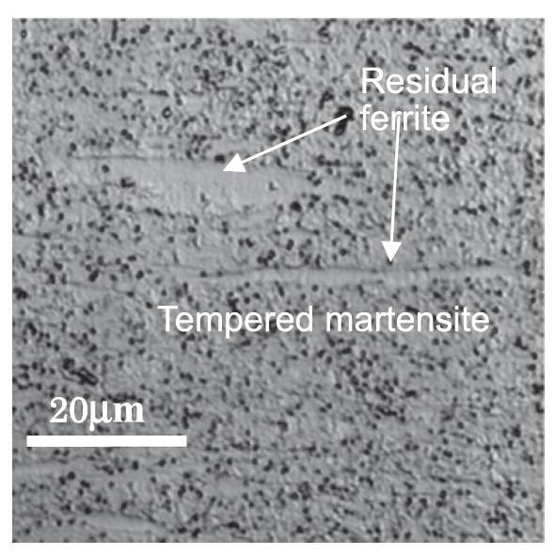
9Cr-ODS microstructure
The microstructure of 9Cr-ODS steel cladding is basically tempered martensite, but includes some residual ferrite phases
Only the full martensite phase can be expected in 9Cr-ferritic steel without yttria under the same conditions
The high temperature strength is greatly improved with the ferrite, and thus control of ferrite is key in ODS fabrication

Slide 22
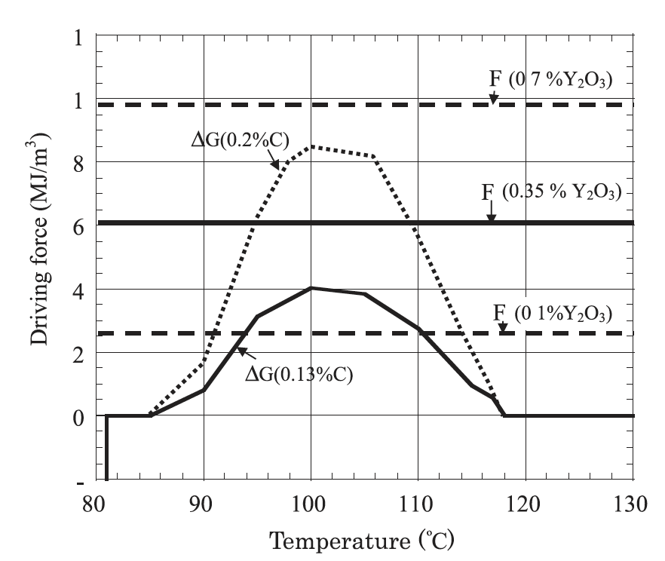
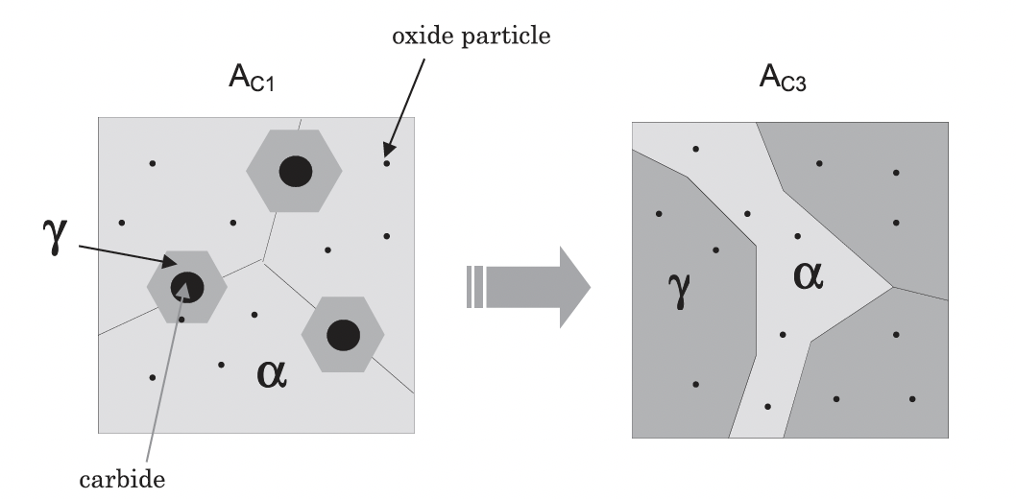
Residual Ferrite
Annealing results in the formation and precipitation of Y–Ti complex oxide particles
This heat treatment should convert ferrite into austenite, but when Y2O3 is present, we retain ferrite at high temperature and through quenching
These oxide particles block the motion of the alpha-gamma interface, there by partly suppressing the reverse transformation from alpha to gamma-phase

Slide 23
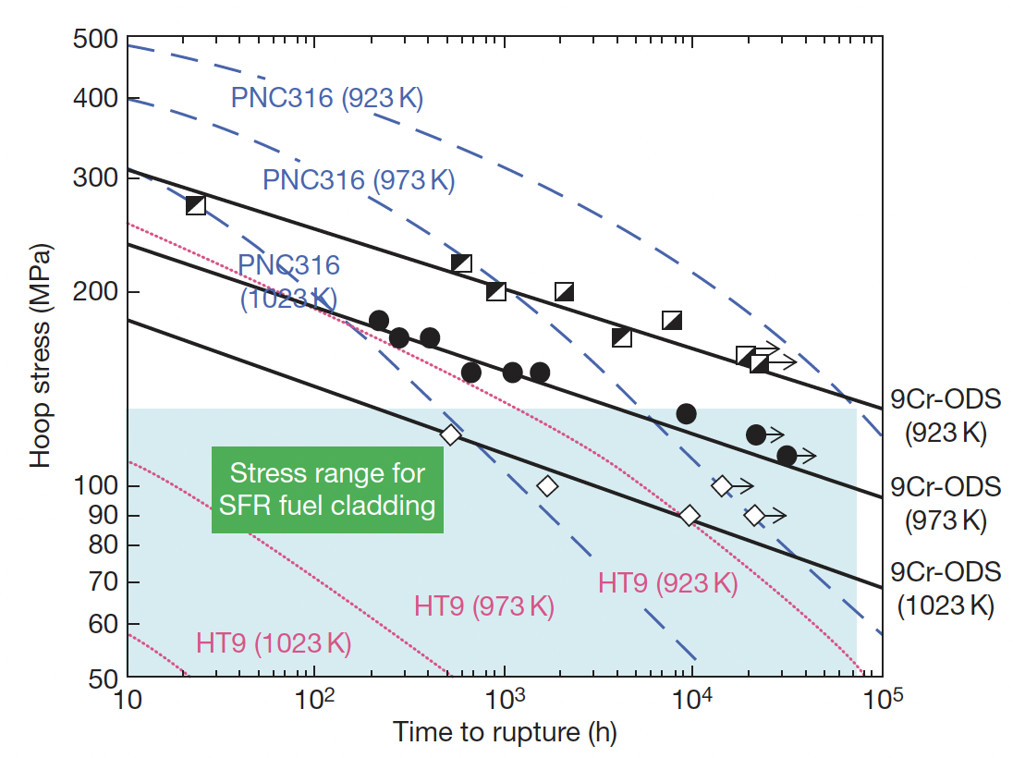
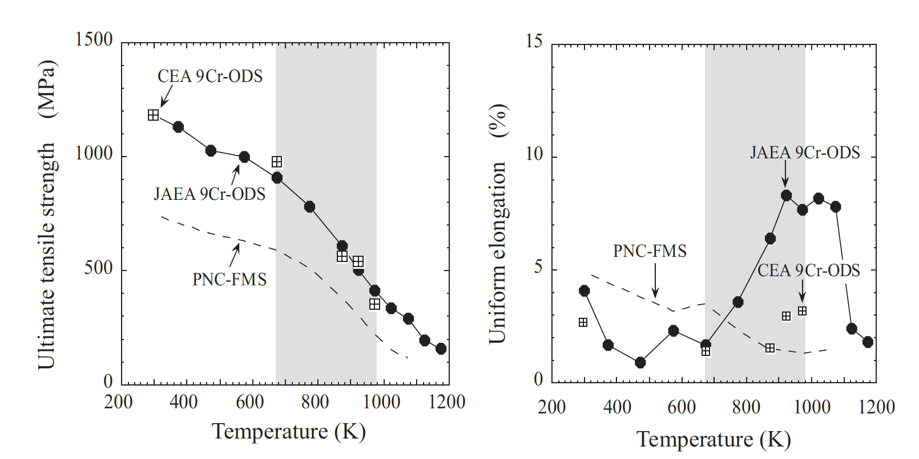
Mechanical Properties
The lifetime of a SFR cladding is mostly determined by the internal creep rupture strength with the internal pressure of the fission gas at a temperature of ~700C
PNC316 is an austenitic steel used developed by JAEA for fast reactors
PNC-FMS is a F/M steel
9Cr-ODS steels have superior creep resistance and higher tensile strength

Slide 24
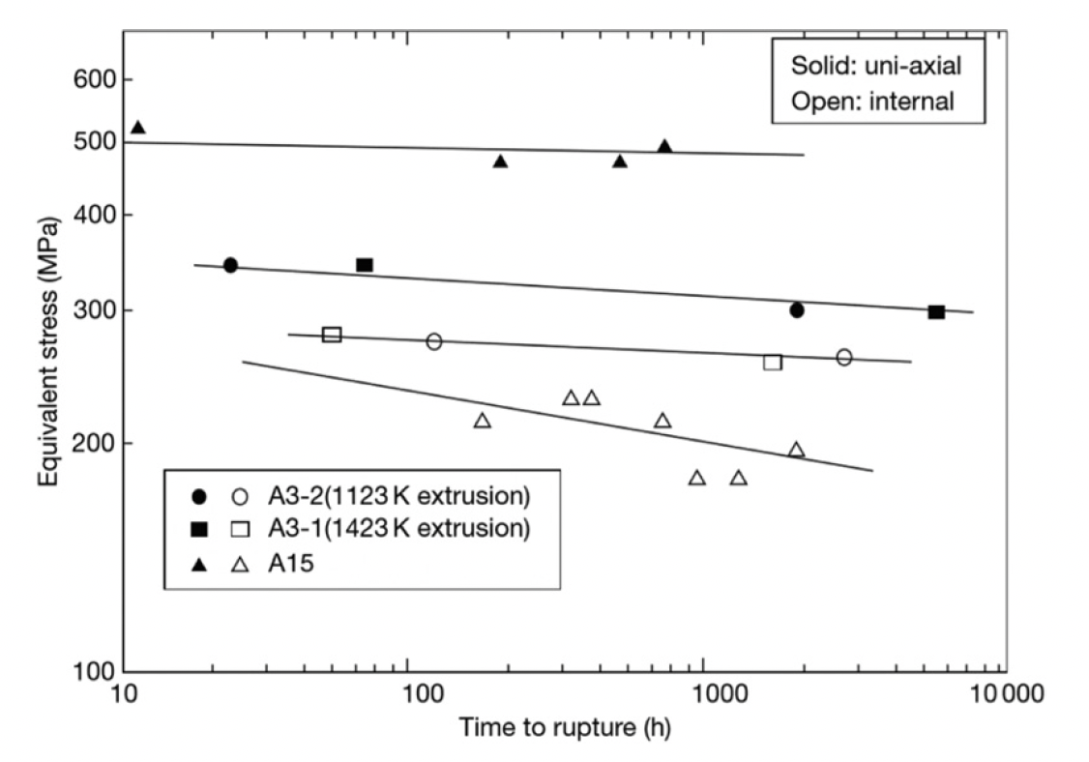
Ferritic 12Cr-ODS Steel
Development of ODS steels began with purely ferritic types, similar to MA957
While these types of steel exhibit excellent creep rupture resistance, there is anisotropy of the rupture strength
Can form elongated grains due to fabrication, weakening cladding in hoop direction
If the Y2O3 content is kept sufficiently low, an equiaxed grain structure can be maintained, providing more isotropic mechanical properties
Creep rupture strength of recrystallized (A3) and unrecrystallized (A15) 12Cr-ODS steels at 650C

Slide 25
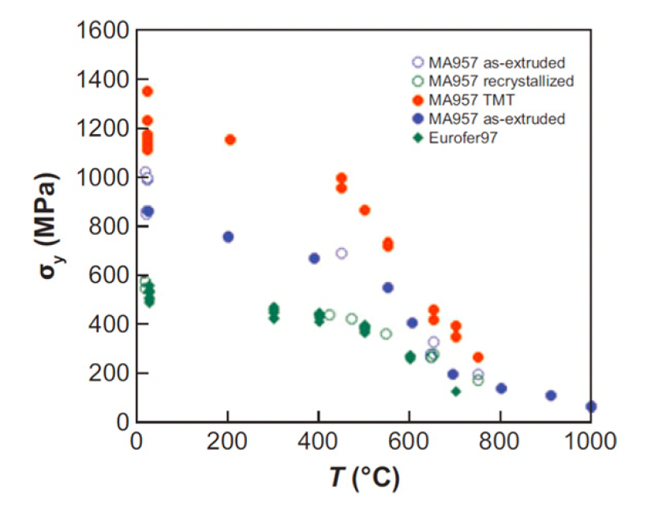
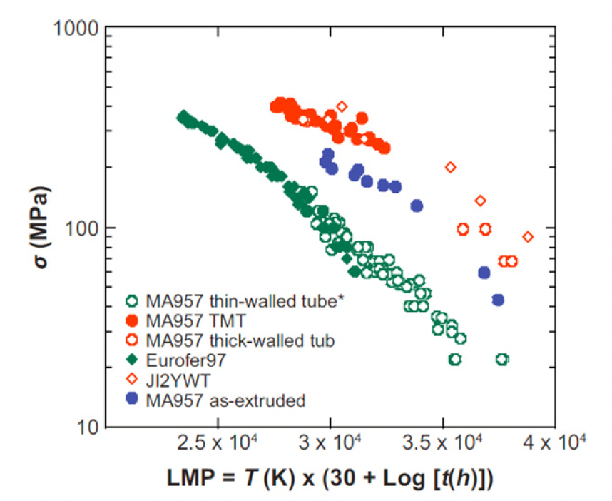
NFAs
Nanostructured ferritic alloys (NFAs) are 12%–20% Cr ferritic stainless steels that are dispersion strengthened by a very high density of ultrafine Y-Ti-O nanofeatures
This high density creates fine grain and dislocation structures
This can yield excellent strength and radiation resistance, but makes fabrication processes very difficult
MA957 is a NFA, Eurofer97 is a tempered martensitic steel

Slide 26
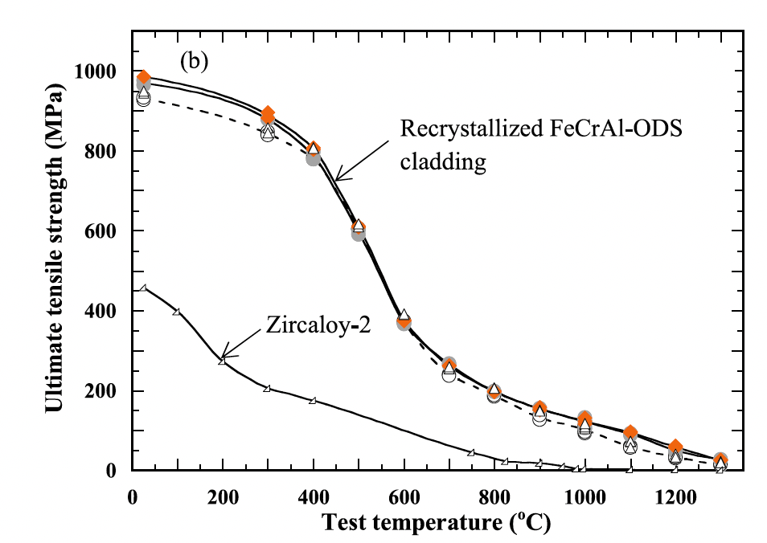
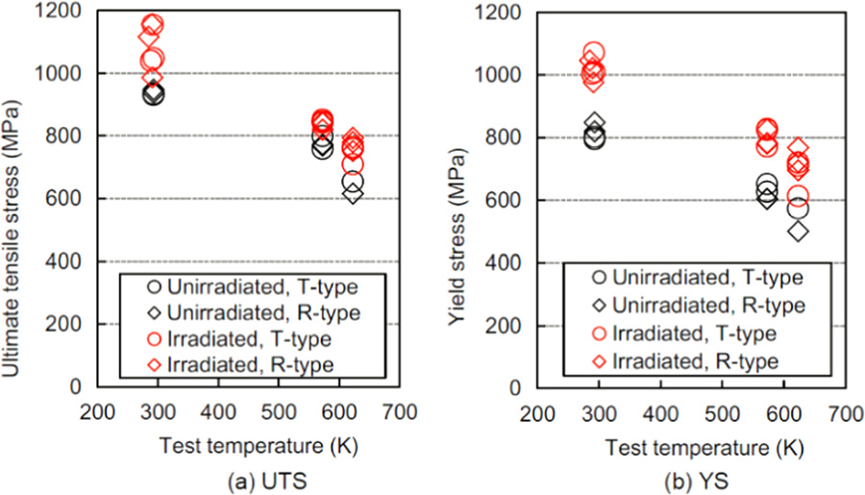
FeCrAl-ODS Steel
FeCrAl steels, with and without ODS are of interest
A nominal composition of Fe-10Cr-6.1Al-0.3Zr (wt%) with 0.3wt% Y2O3 has been studied by ORNL, a number of different alloys explored by JAEA program
Zr is added to prevent ‘large’ Y-Al oxide particle formation
The creep rupture strength of Zr-added FeCrAl-ODS cladding is beyond the existing 9CrODS and 12CrODS steel claddings for fast reactors
T-type (transverse direction) and R-type (rolling direction)

Slide 27
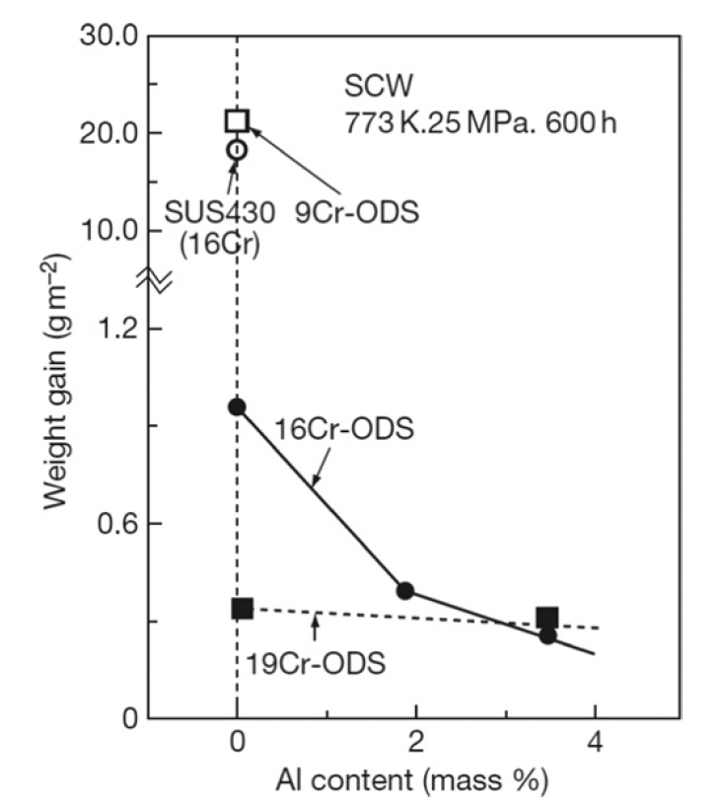
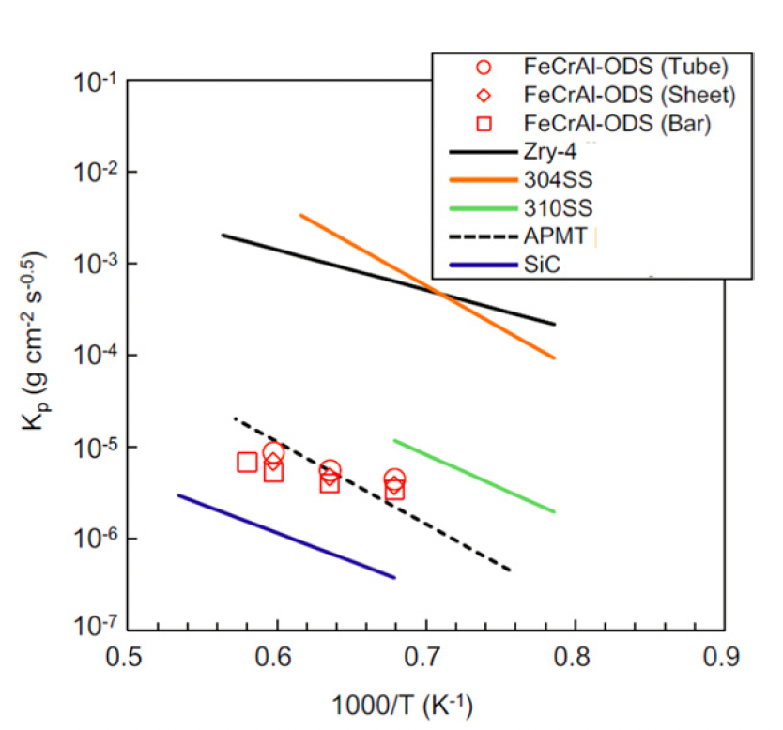
Corrosion
Hot steam oxidation tests are fairly limited in ODS steels
Additional Cr improves corrosion resistance, and Al content greater than 2 wt% provides a protective barrier
Excess oxygen content in the alloys can serve to suppress corrosion
In systems with high amounts of excess oxygen, Zr content can further aid in corrosion resistance

Slide 28
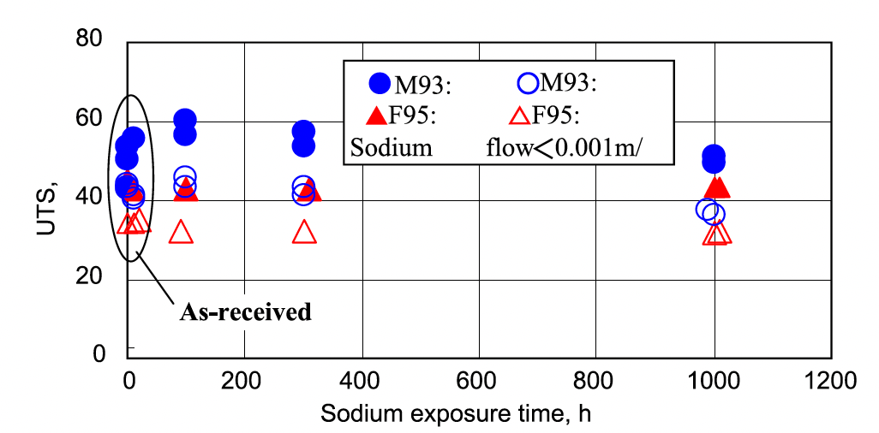
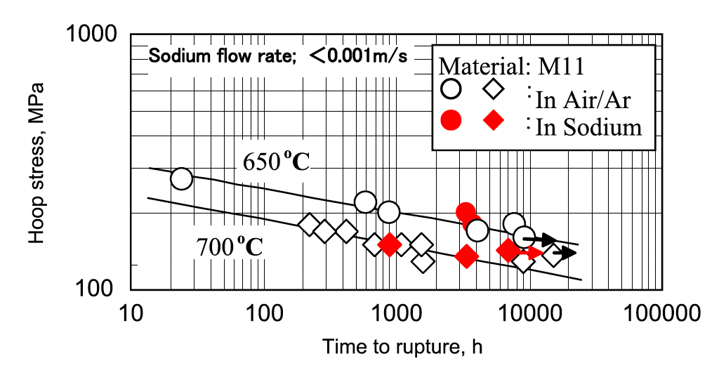
Liquid Na Compatibility
OSD-steels display excellent compatibility with liquid sodium
Both 9Cr and 12Cr ODS steels show no degradation in UTS after prolonged exposure to Na
Creep rupture behavior of ODS steels in air is identical to that in liquid Na
Under irradiation, this corrosion behavior may change, but has not been thoroughly studied

Slide 29
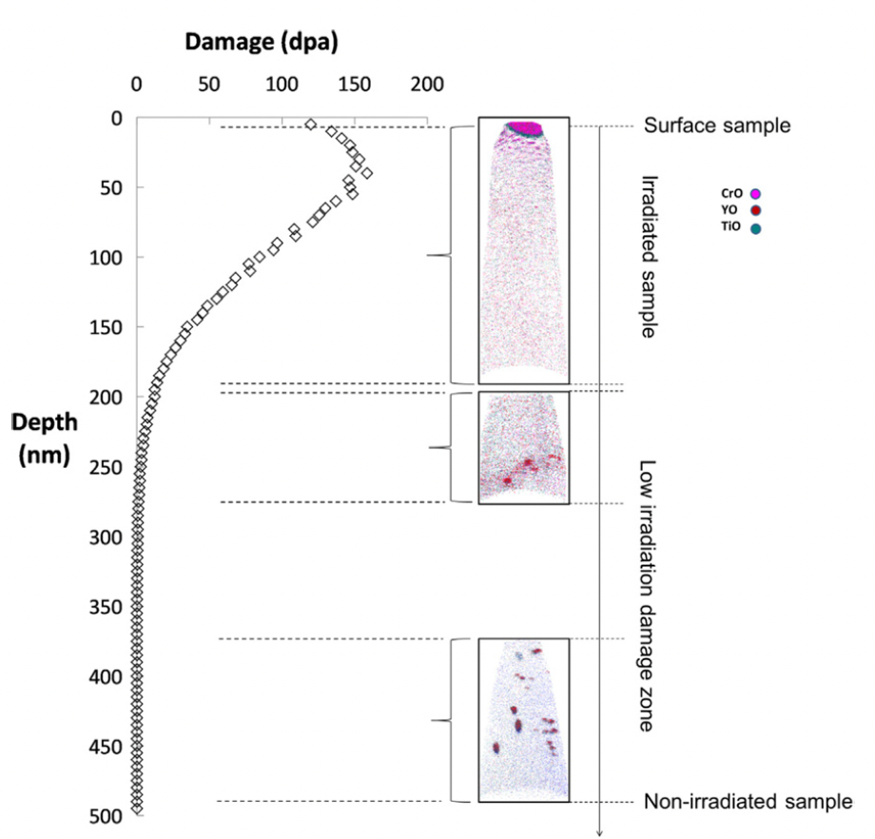
Irradiation Effects
The stability of the oxide particles under irradiation is the key factor in these alloys maintaining their advantageous mechanical properties under operation
Ballistic dissolution-the ejection of atoms from oxide particles due to high energy PKAs and the disordering of the particles-changes the nature of particles under irradiation
Complete dissolution of particles has been observed via APT

Slide 30
Irradiation Effects
At higher temperatures where vacancy diffusion is possible, ballistic dissolution works in conjunction with irradiation-assisted diffusion and changes the oxide particles
The atoms ejected from oxide particles can diffuse back to the original oxide particles, stay in the matrix, or reach other oxide particles
Most studies have reported that the size and number density of the oxide particles hardly change compared to how they were before irradiation
The predominant mechanism of of recovery is the back diffusion to the original oxide particles or re-joining to other existing oxide particles

Slide 31
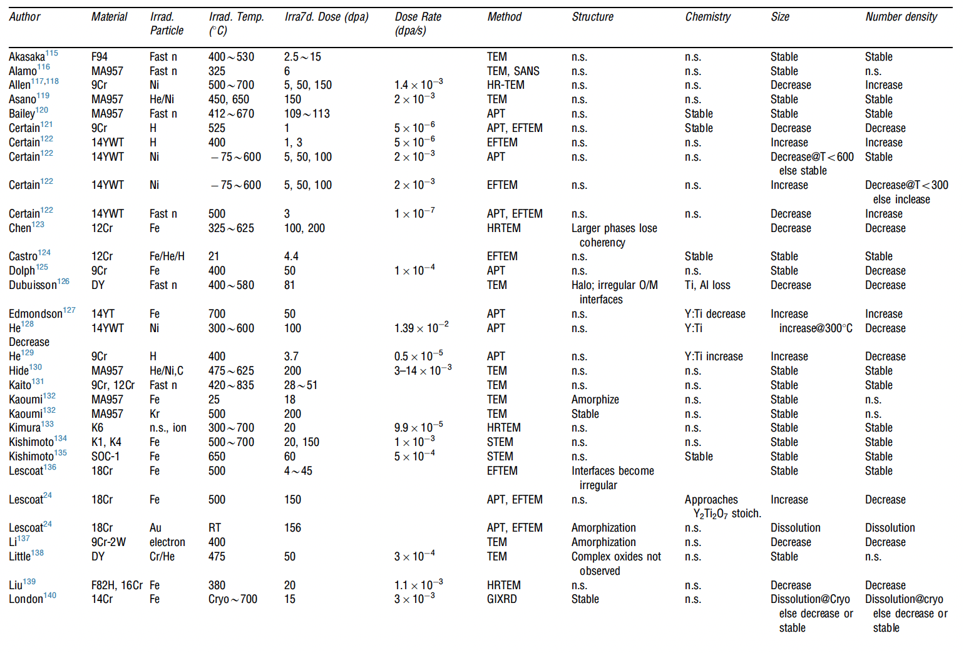
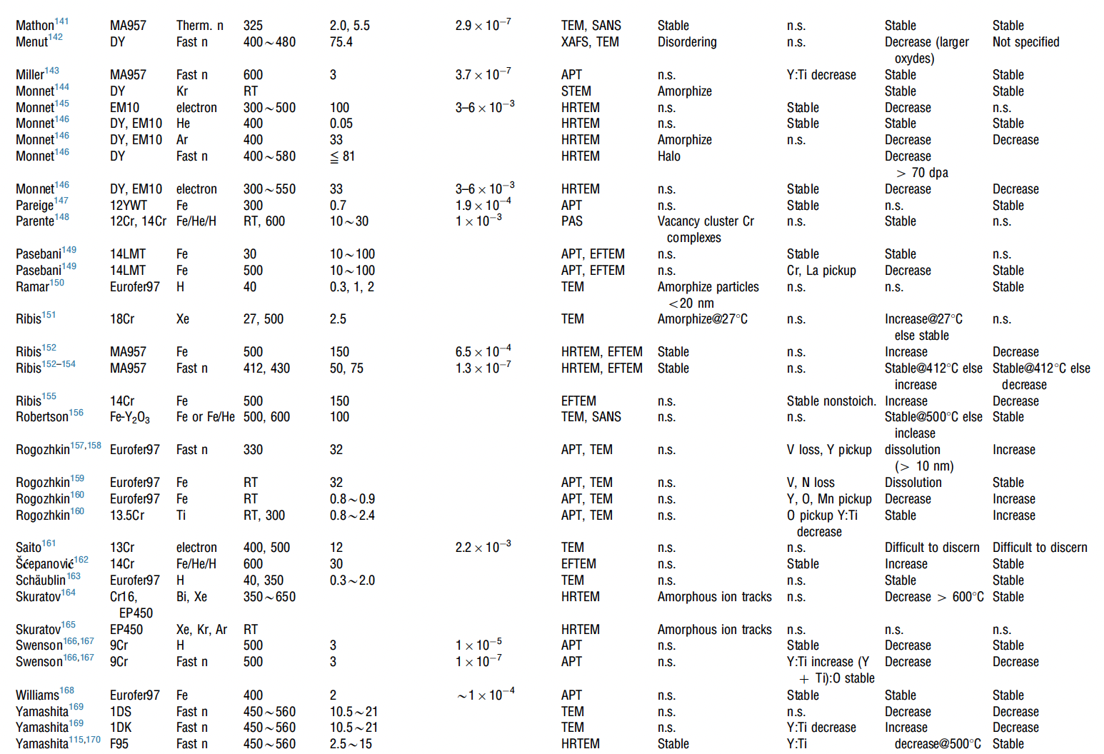
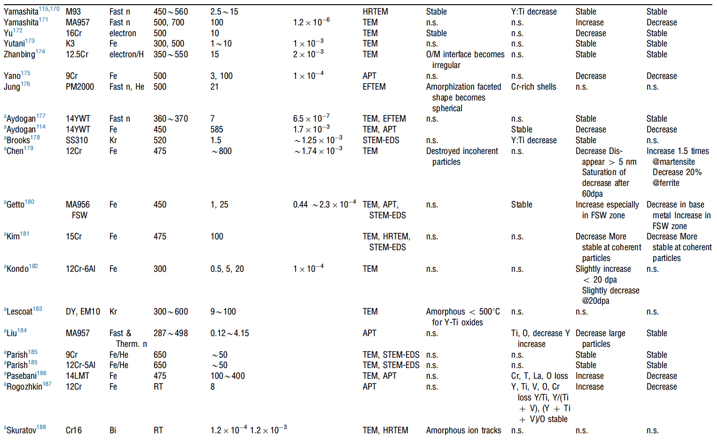
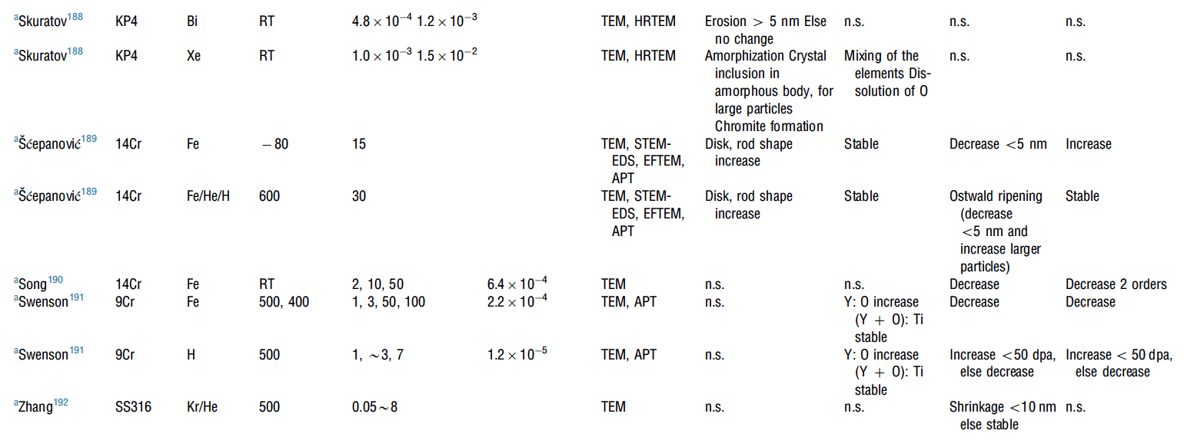
Irradiation Effects
A large number of irradiation experiments have been performed and analyzed to study the evolution of oxide particles
It appears that there is no correlation between irradiation dose, irradiation temperature, and the trend of change in size or number density of oxide particles

Slide 32
Irradiation Effects
Swelling:
ODS steels are very swelling resistant, as the oxide particles trap vacancies and gas atoms, resulting in very small and homogeneously dispersed voids/bubbles
Hardening:
hardness increases due to irradiation in ODS steels are smaller than in non-ODS steels
Oxide particles dominate hardness, and act as sinks for generated point defects

Slide 33
Summary
ODS is fabricated through mechanical alloying and subsequent annealing
9Cr-ODS steel has a unique structure consisting of tempered martensite and residual ferrite that induces superior strength through finely dispersed oxide particles
NFAs have a very high density of oxide particles, producing very high strength and creep resistance, at the cost of workability
FeCrAl-ODS can provide superior corrosion resistance while retaining the ODS influenced mechanical properties
Further in-reactor studies on ODS steels need to be performed
While performance of ODS steels is widely studied, current production is limited to laboratory scale, with prohibitive costs for large scale production

Slide 34
High entropy alloys

Slide 35
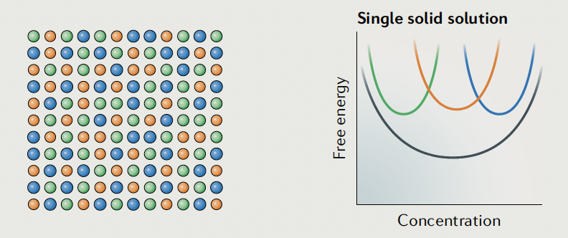
HEAs
The ‘normal’ alloying strategy adds relatively small amounts of secondary elements to a primary element
The combination of multiple principal elements in high concentrations to create new materials yields HEAs
It was theorized that the presence of multiple elements in near-equiatomic proportions would increase the configurational entropy of mixing by an amount sufficient to deter the formation of potentially harmful intermetallics
These can also be called multi-component alloys, compositionally complex alloys and multi-principal-element alloys (some delineations between the groups)

Slide 36
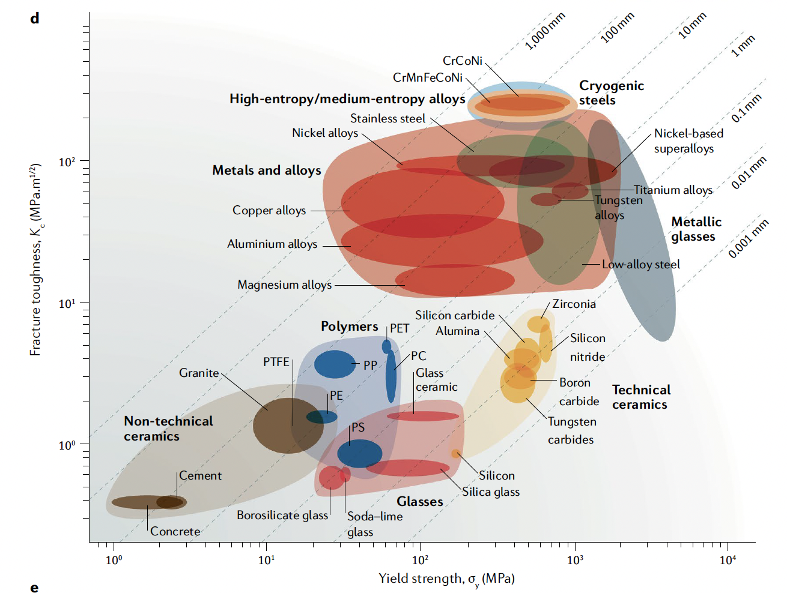
High strength and high ductility
HEAs have numerous appealing properties, such as great strength, great hardness, resistance to corrosion, fracture and fatigue resistance, and high-temperature stability
The concept of solid-solution strengthening is that solute atoms impede the motion of dislocations, increasing the yield strength
In HEAs, there is no single solute, and thus the local disorder/distortion acts as a strong barrier to dislocation motion

